Slide 1
Wanna See a UFO?
Connor, Tom, Marisabel, Amy, Brian

Slide 2
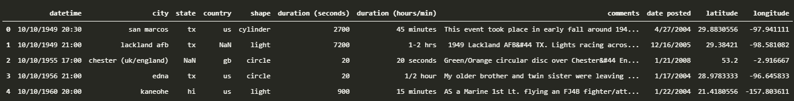
Motivation
National UFO Reporting Center
Data on reported UFO sightings dating back to 1949
Original CSV downloaded from Kaggle
Date/Time, City, State, Shape, Summary
Analyze data to try and make predictions about likelihood of UFO sightings in different areas
Further analysis into other attributes to help increase the chance of a UFO sighting

Slide 3

Summary
Does the population of city/state/country affect the rate of UFO sightings?
Is it better to be somewhere with a lot of people, or somewhere more sparsely populated?
What are the most common shapes?
What is the best shape/UFO to try and look for?
What dates/times produce more UFO sightings?
When are the best times of day to go outside?
Are there any common themes in the descriptions of the UFO sightings?
Are there any other details we can pull out from the summary to try and get a more immersive experience?

Slide 4
Questions
Does the population of city/state/country affect the rate of UFO sightings?
City/State from the NUFORC data
Population from the Census
What are the most common shapes?
NUFORC data
Potentially needs cleaned up
What dates/times produce more UFO sightings?
NUFORC data
Split into time periods (day vs. night, dawn vs. dusk, etc.)
Are there any common themes in the descriptions of the UFO sightings?
NUFORC data
Word cloud, Flesch-Kincaid score

Slide 5
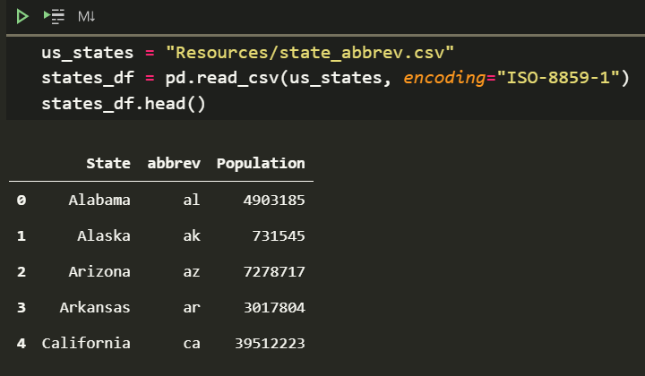
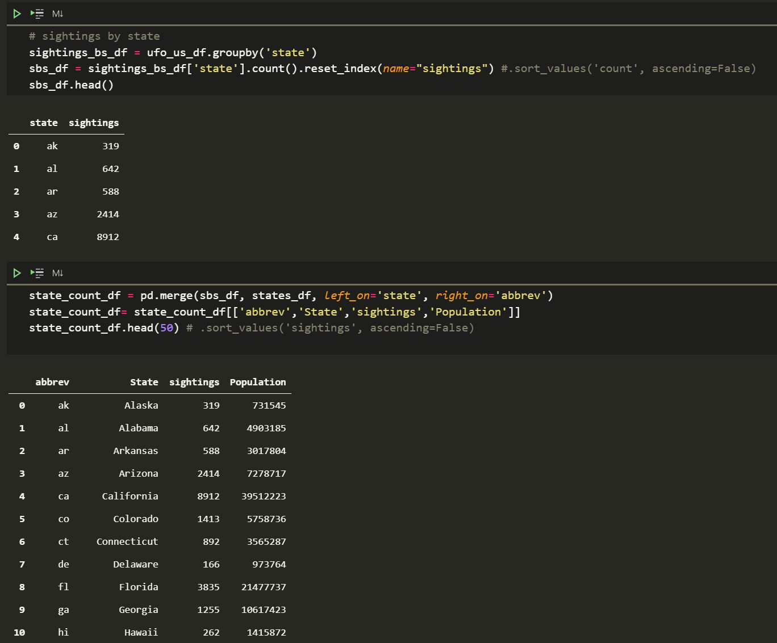
Getting Population Data

Slide 6
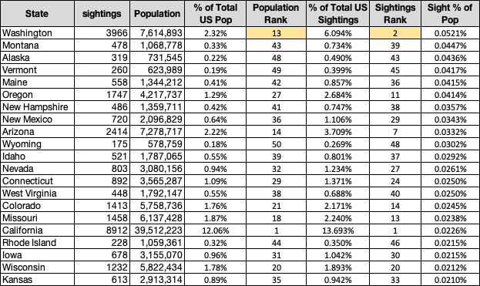
Interesting Population Insight

Slide 7
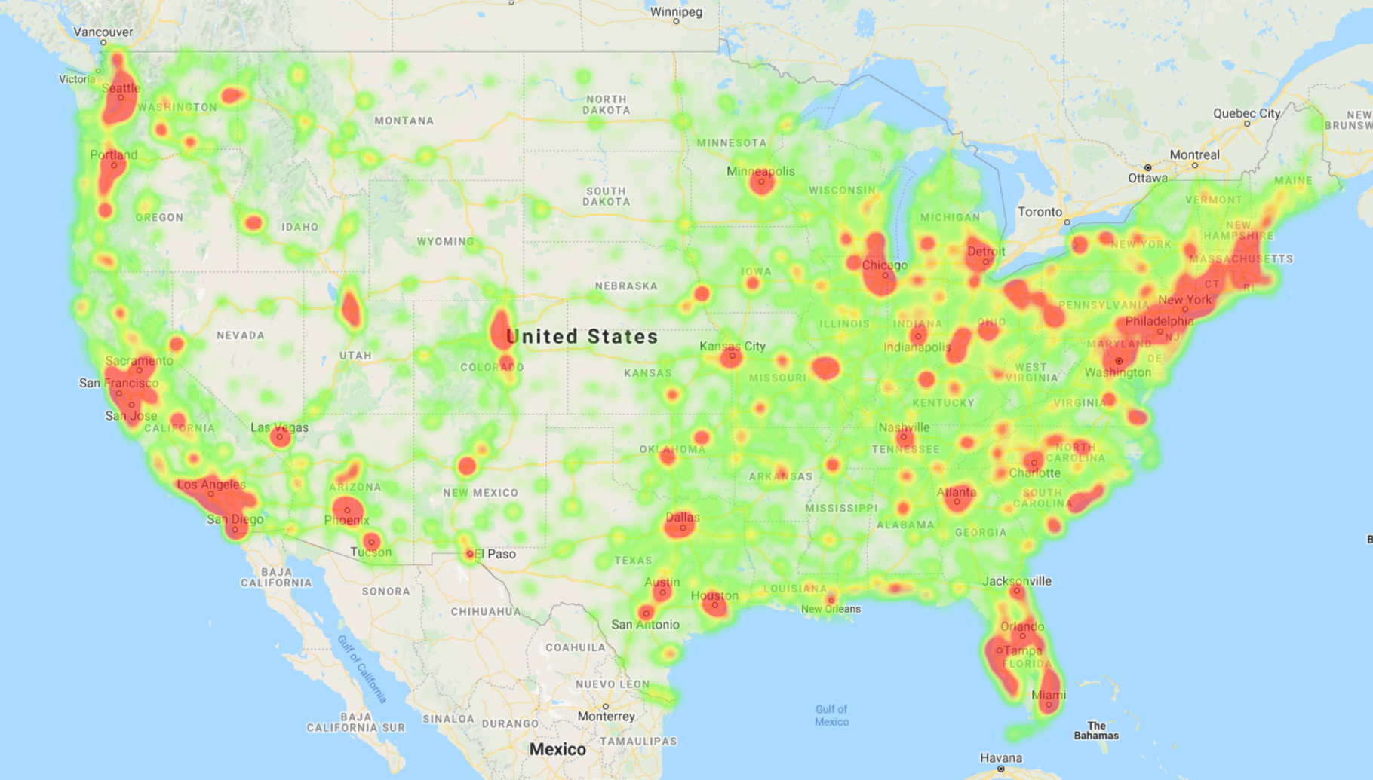
Heat Map of UFO Sightings

Slide 8
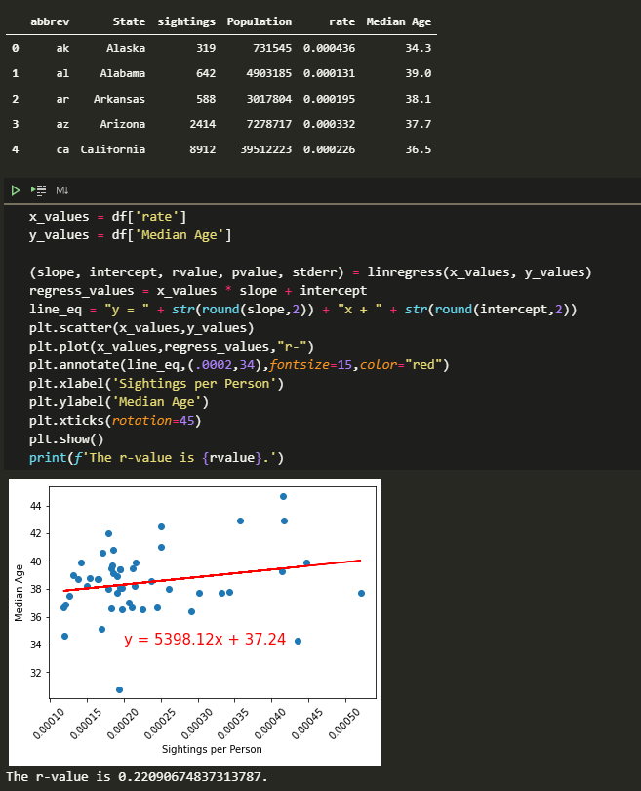
Median Age vs. Sightings

Slide 9
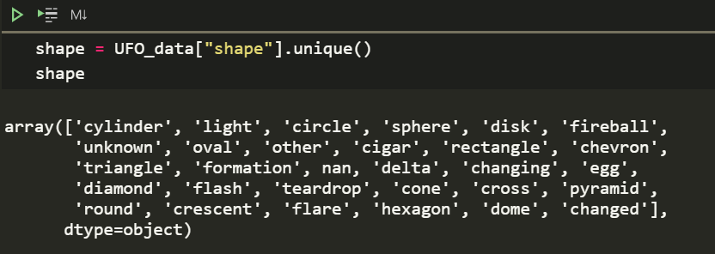
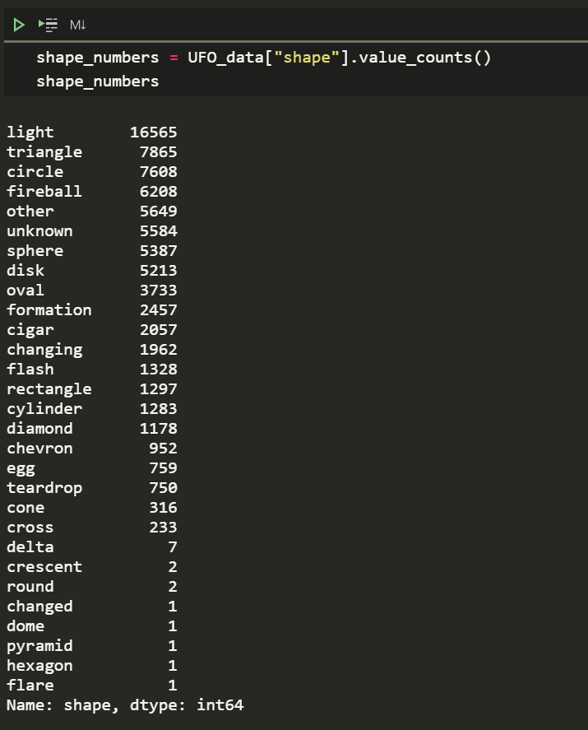
Shape Overview

Slide 10
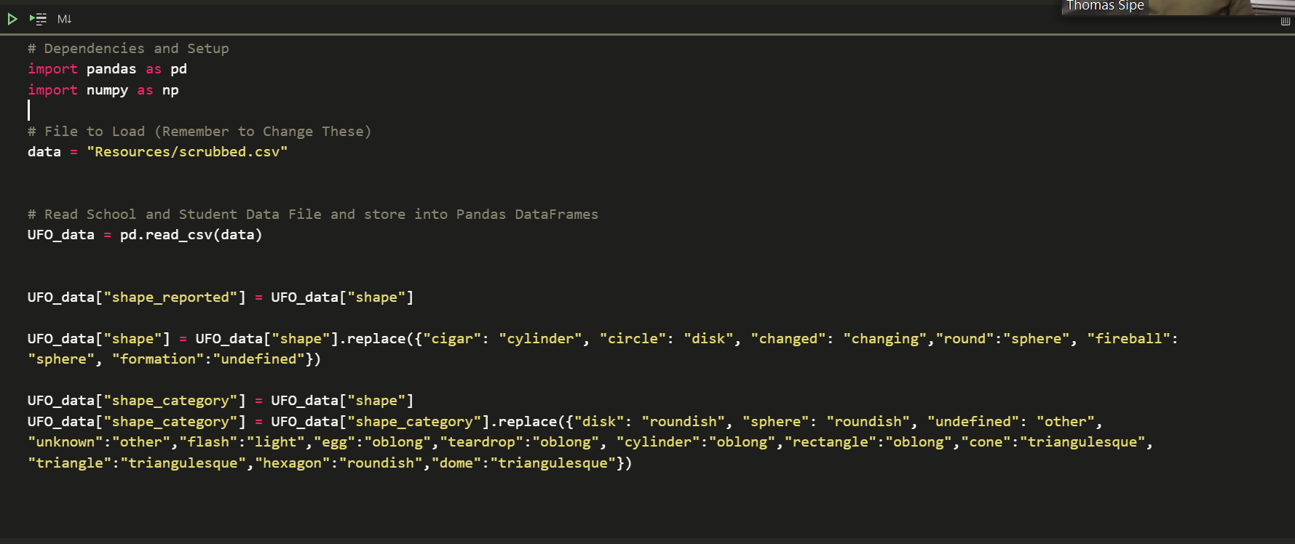
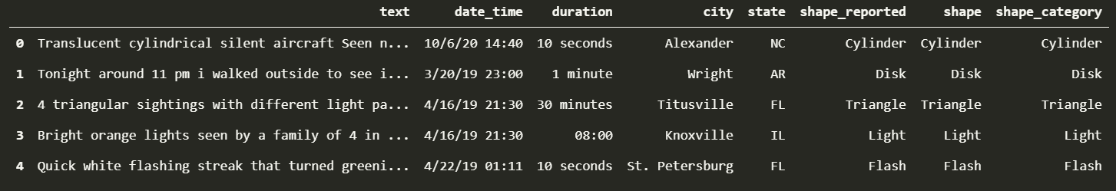
Combining Shapes

Slide 11
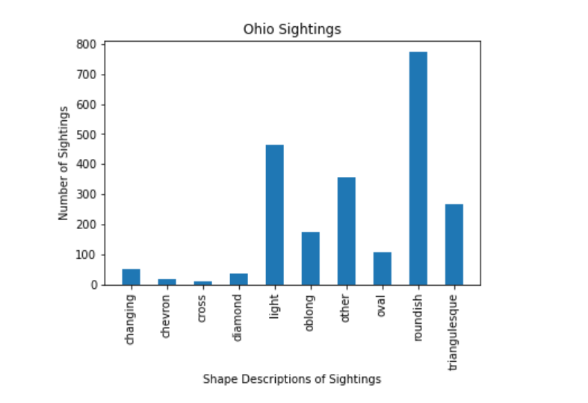
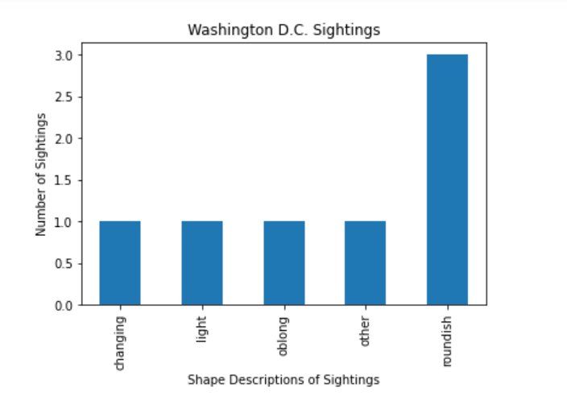
Sightings by Shape

Slide 12
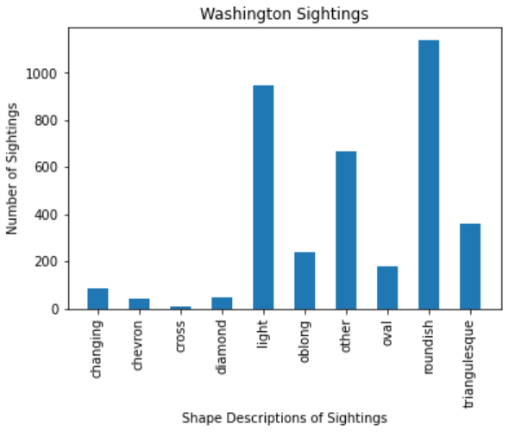
Washington State Sightings

Slide 13
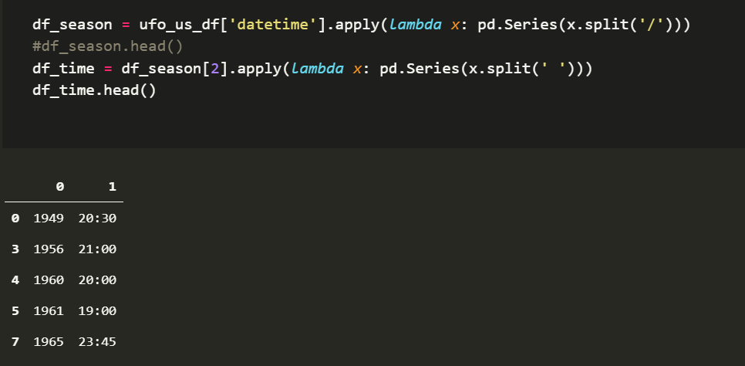
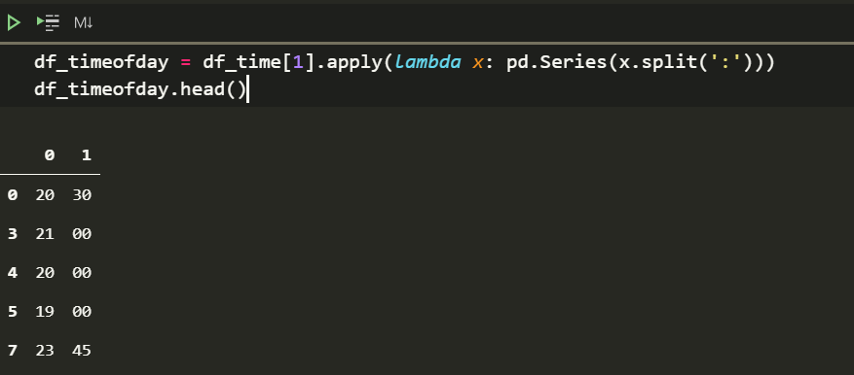
Cleaning up Date/Time

Slide 14
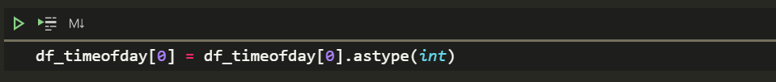
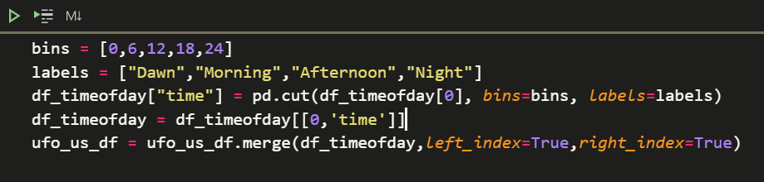
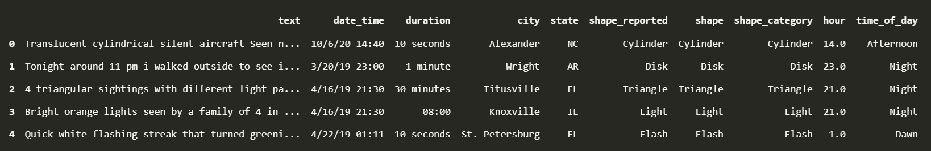
Cleaning up Date/Time

Slide 15
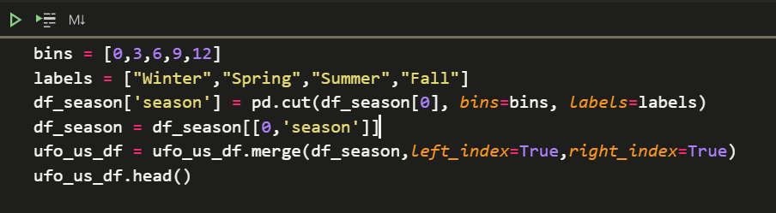
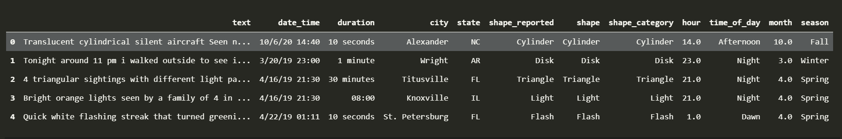
Cleaning up Date/Time

Slide 16
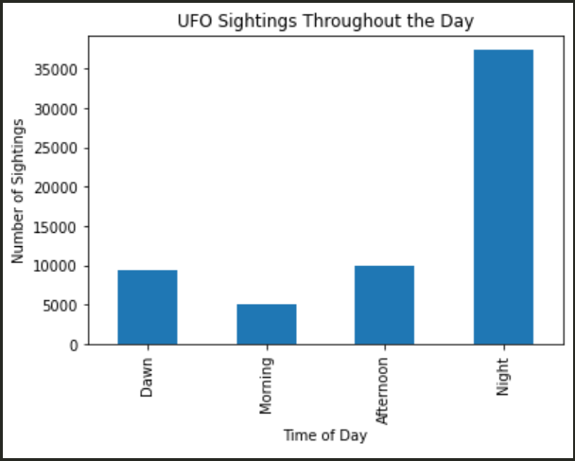
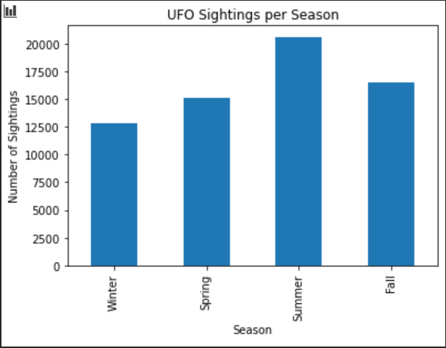
Sightings by Time/Season

Slide 17
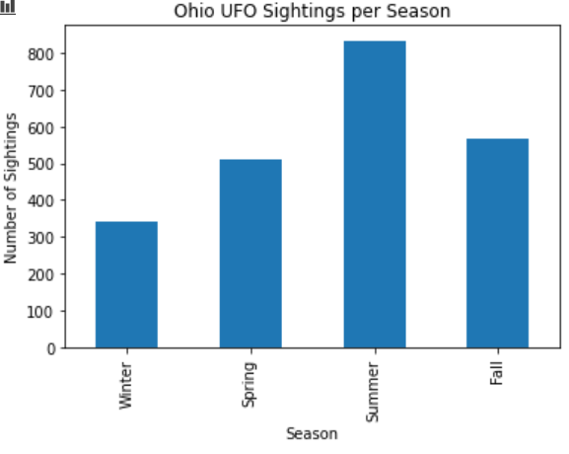
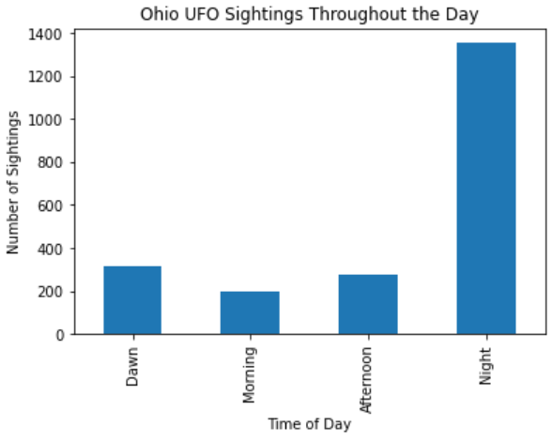
Ohio Sightings by Time/Season

Slide 18
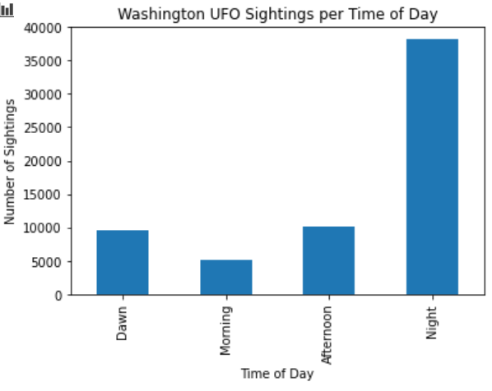
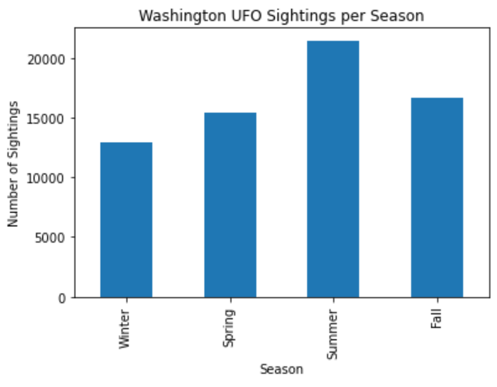
Washington Sightings

Slide 19
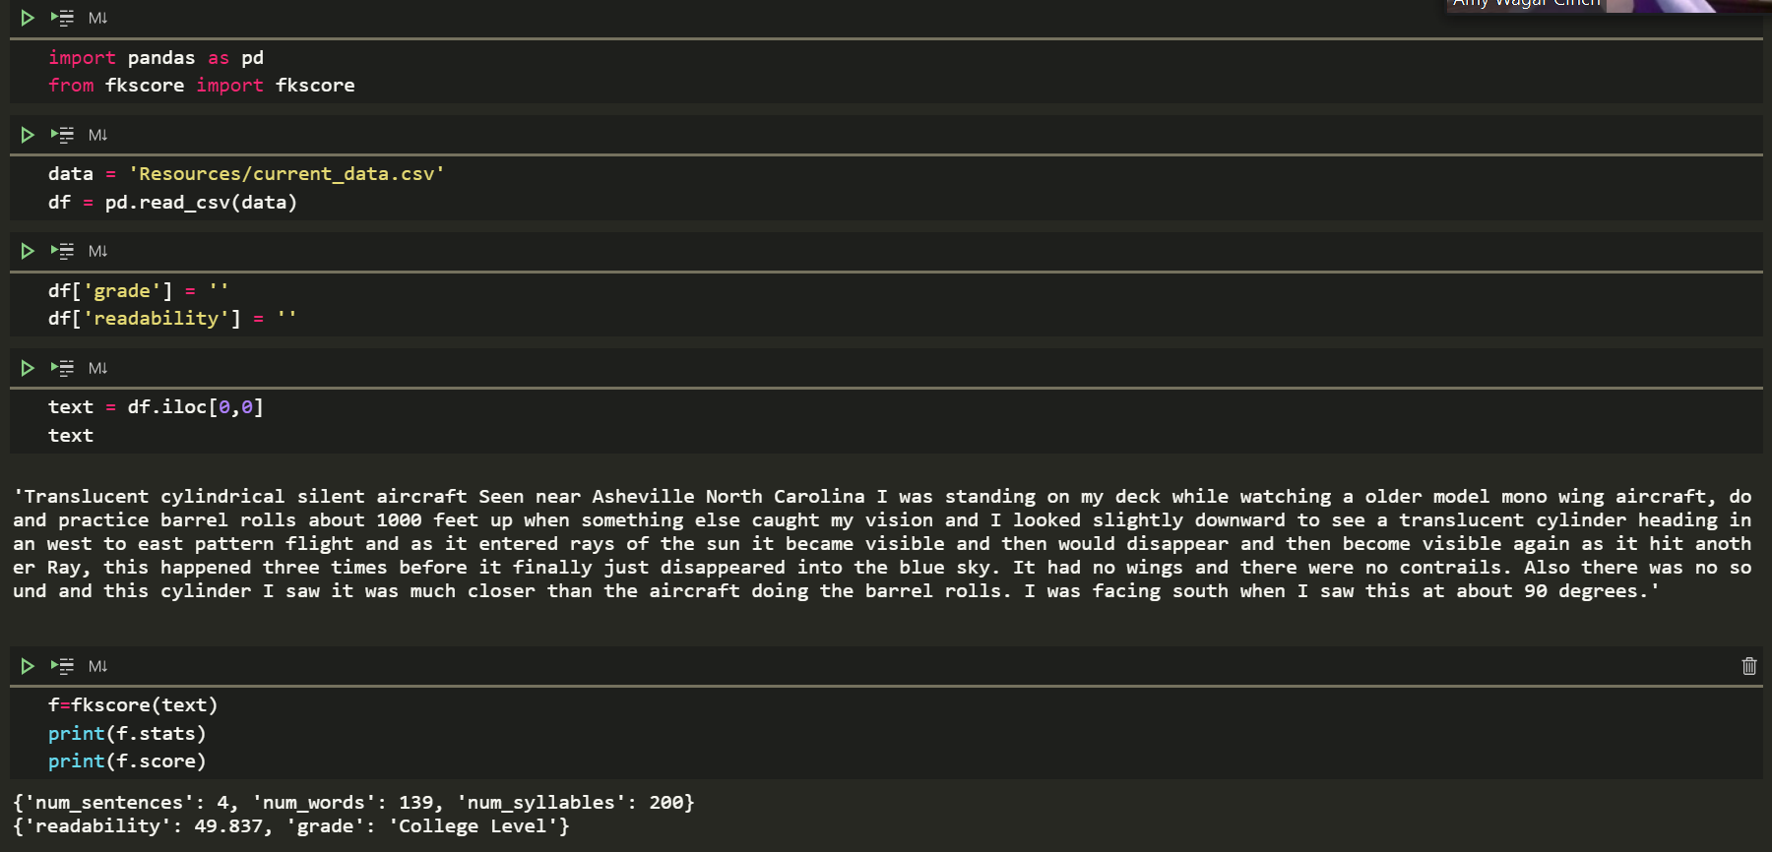
Text Readability

Slide 20
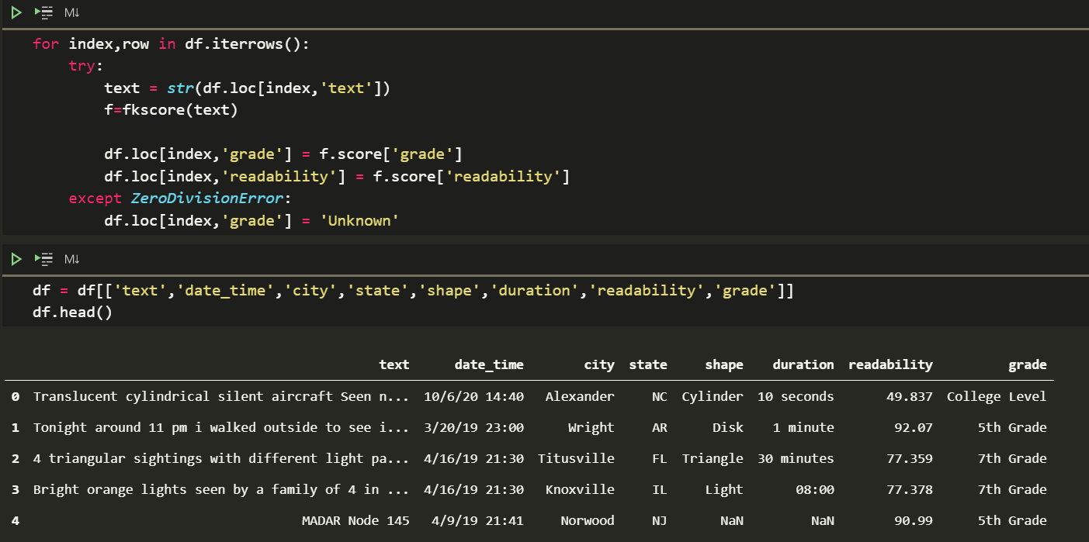
Text Readability

Slide 21
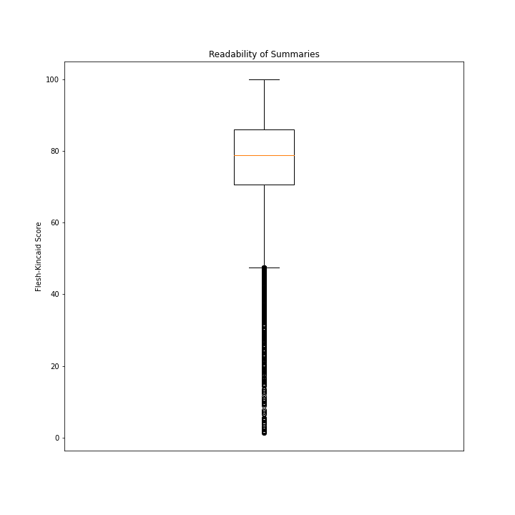
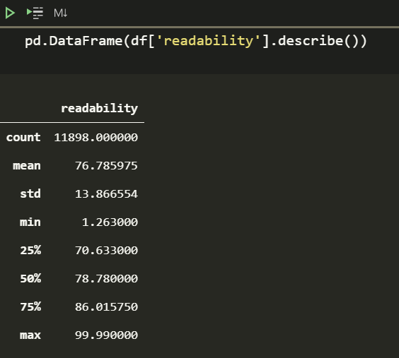
Text Readability

Slide 22
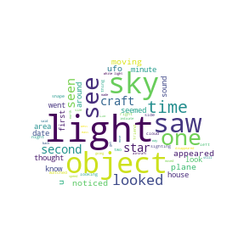
Word Cloud!

Slide 23
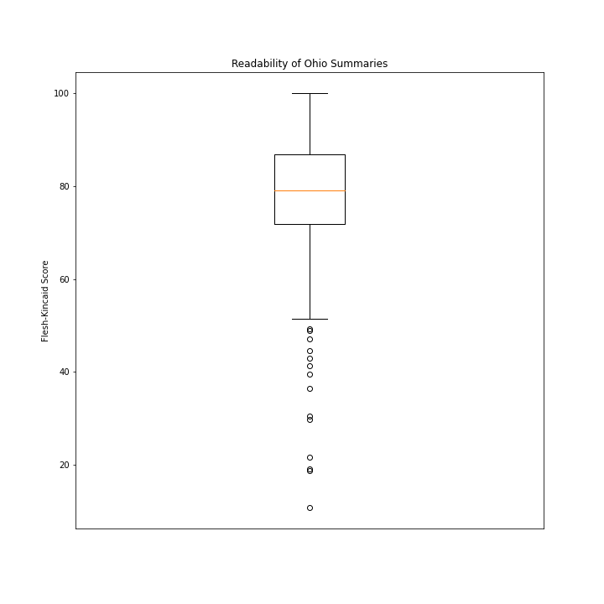
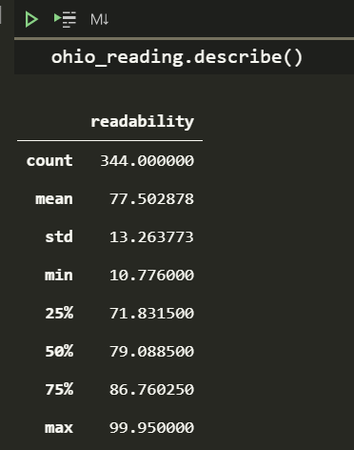
Ohio Text Readability

Slide 24
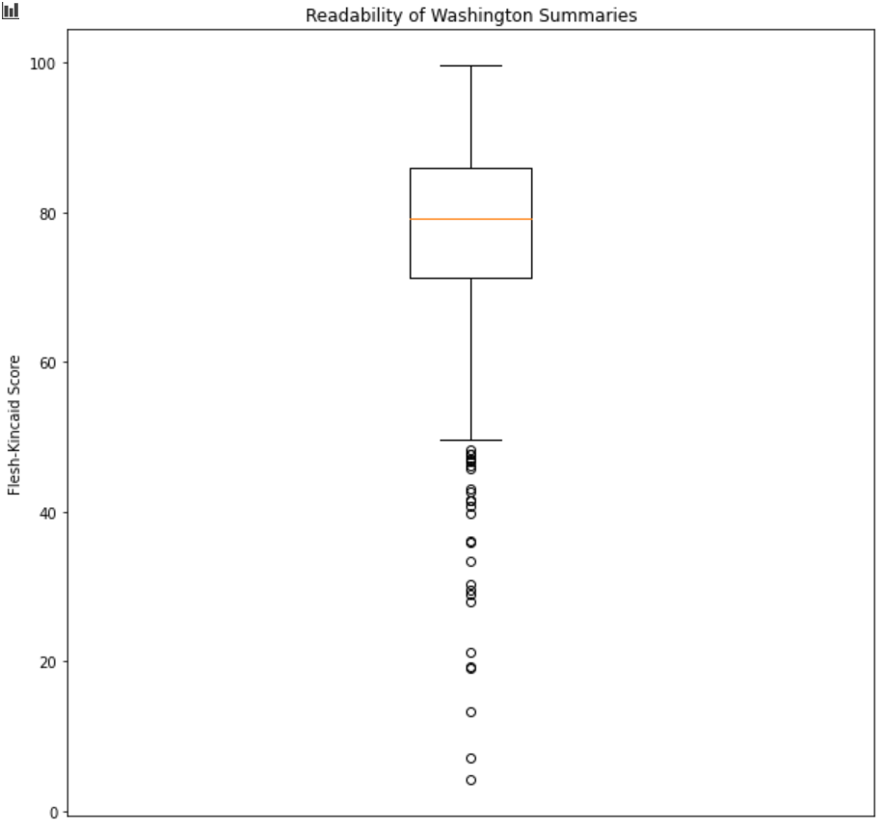
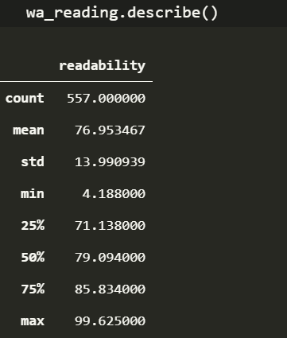
Washington Text Readability

Slide 25
Data Limitations
CSV from Kaggle contained data from 1949 – 2013. Very broad, so to get really picky with population would take more work.
Found a github project that contained web scraper that can download more data from the NUFORC website
Ran it for 8 hours uninterrupted and scraped data from 2020 back to 2006ish
CSV text summaries only contained a very short snippet from the beginning of the entire comment
Was able to do some analysis on the data from the web scraper
Census population data needs pulled by zipcode using the census wrapper
Would need to find an easy way to convert city, state to a zipcode
Only found APIs that were limited in availability/very pricey

Slide 26
Ideal UFO Sighting Setup
Go to Washington state – Highest sightings per person!
Look to the sky on clear summer nights!
Look for round shapes with lights!
Other sightings in Washington state were described at an 8th-9th grade reading level!
Ohio UFO Sighting Setup
In Ohio, there are about .000194 UFO sightings per person!
Look to the sky on clear summer nights!
Look for round shapes with lights! You might even see something triangular!
Other sightings in Ohio state were described at an 8th-9th grade reading level!

